Slide 1

Temporal-spatial changes of the unemployment rate in the contiguous USA By Matthew Heino

Slide 2

Sections Covered
1. Data
2. Project Objectives
3. Data Processing and Objectives
4. Discussion and Conclusion
5. References

Slide 3

1. The Data

Slide 4

The Data
Consisted of three data files:
crime_and_incarceration_by_state.csv
holds information about crime statistics for each state and other data.
composed of 18 different variables
unemployment_county.csv
contains data about the unemployment rate by county
tl_2019_us_state.shp
shape file that will be used in the mapping the data

Slide 5
2. Project Objectives

Slide 6

Project Objectives
determine if there is a correlation between the rate of crime and unemployment.
seeks to see if there is an observable correlation that be seen either graphically or seen in a mathematical supported way.
a discussion of the findings. The data topic that will be covered in this project will be the temporal-spatial changes of unemployment rate in the contiguous USA

Slide 7
3. Data Processing and Objectives

Slide 8
Data Processing and Objectives
Steps that followed to prepare the data for analysis:
Read the data from the CSV files into individual data frames. Section: 3.0.1 .
Remove the parts of the United States that are not contiguous. Section: 3.0.2 .
Process the unemployment rate data. Section: 3.0.3
Process the crime rate data. Section: 3.0.4
Join relational tables. Section: 3.0.6
Save the final combined and cleaned data. Section: 3.0.7
Note: The sections at the end of the bullet refer to the section of the RMD file that accompanies this PowerPoint presentation.

Slide 9
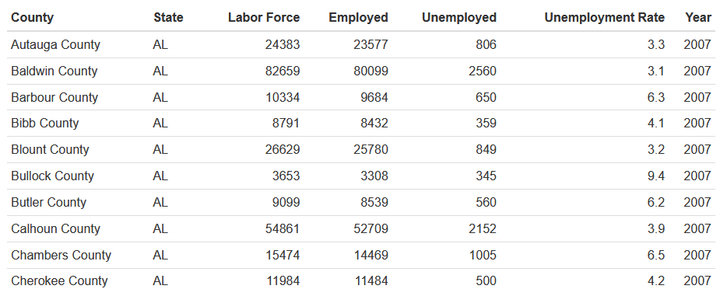
Data Processing and Objectives
Read the data from the CSV files into individual data frames. Section: 3.0.1 :
The unemployment_county.csv had the following layout:
Table 3.2: Unemployment Rate

Slide 10
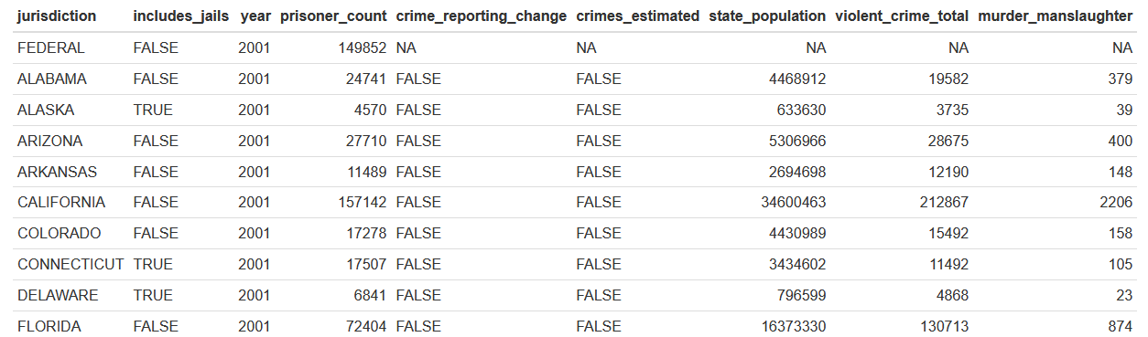
Data Processing and Objectives
Read the data from the CSV files into individual data frames. Section: 3.0.1 :
The crime_and_incarceration_by_state had the following layout (Table 3.2 Crime and Incarceration by State) :

Slide 11
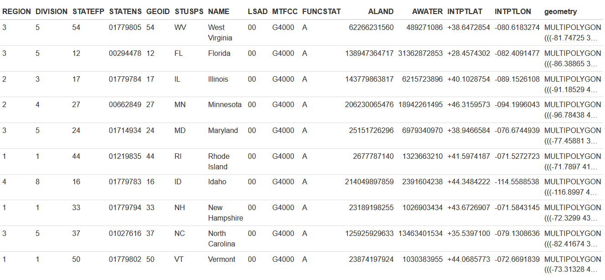
Data Processing and Objectives
Read the data from the CSV files into individual data frames. Section: 3.0.1 :
The t1_2019_us_state.shp had the following layout (Table 3.2: States)
Note: This image does not contain all the data that was in the file. It only contains the first ten rows of data.

Slide 12
Data Processing

Slide 13
Processing The Data
The data was not in a state where it could be used. The following steps were performed to get the data into a usable state for analysis.
Steps:
State polygons (file)
remove some states that are not part of the contiguous USA
unemployment_county (file)
remove some states that are not part of the contiguous USA
rename the state column
filter years: 2007-2014
crime_and_incarceration_by_state (file)
change state column name.
remove some states/region.
change all the states in capital case into 2-letter abbreviation name.

Slide 14
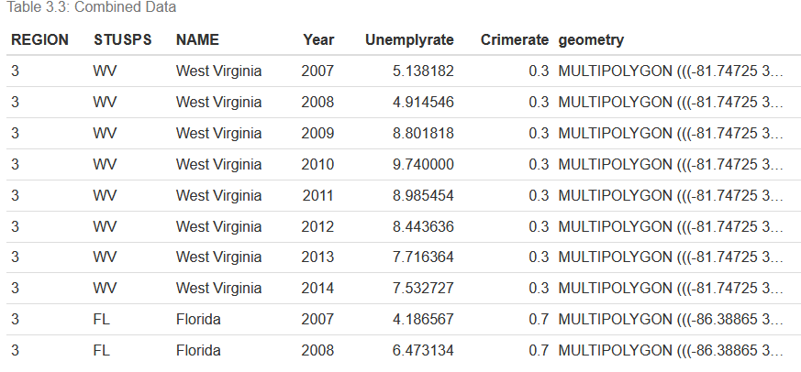
Processing The Data
There were a few additional steps that were accomplished in the section.
calculate the crime rate
join relational tables
The result is the following table.
Note: Additional information can be found in the accompanying HTML file.

Slide 15
EDA analysis (Unemployment)

Slide 16
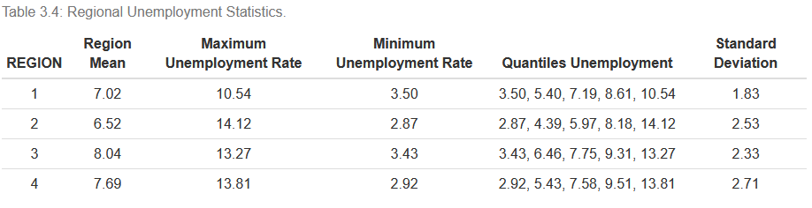
EDA analysis
To aid in understanding what the data looks like it was beneficial to gather some statistical data about the cleaned data. Exploratory data analysis was performed on the data. Statistics that were gathered were quantiles and the mean, minimum, and maximum The following is a chart of the aggregated unemployment based on the region. And is followed by a boxplot for the same data

Slide 17
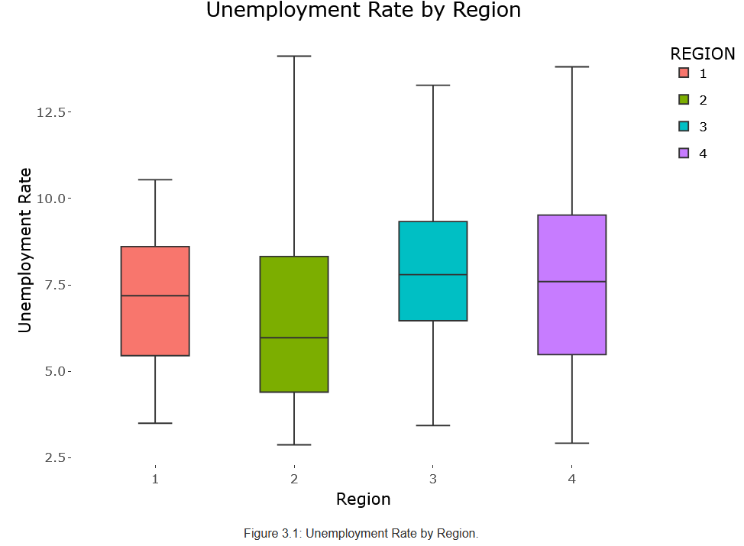
EDA analysis
Note: The boxplot is a plotly plot that is fully interactive in the HTML document.

Slide 18
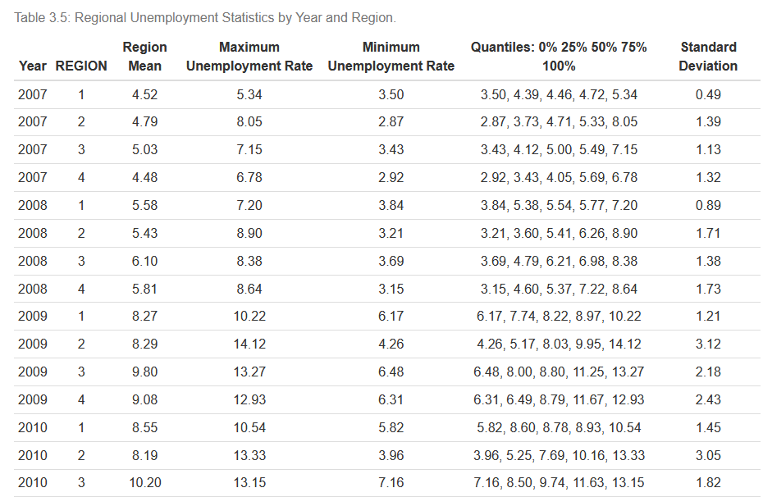
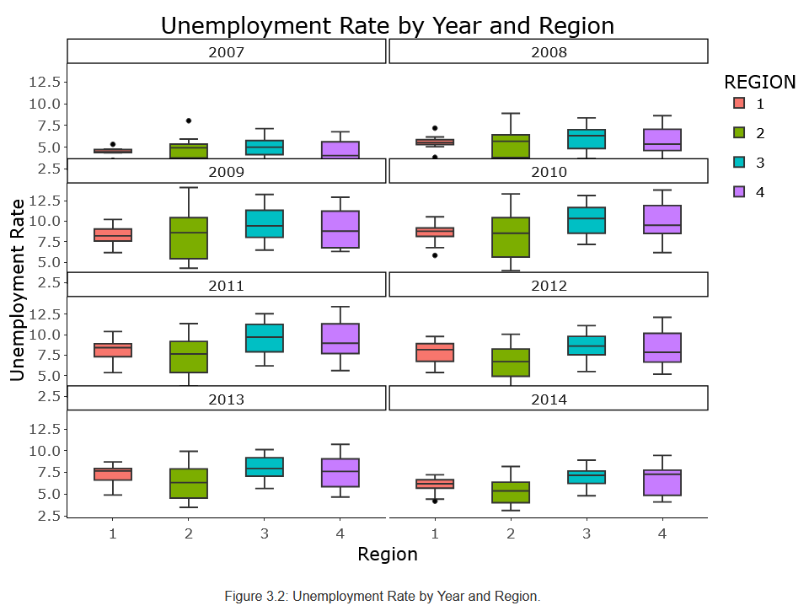
EDA analysis
Unemployment by year is shown in the table and boxplot below. Note: This is only a partial image of the table

Slide 19
EDA analysis (Crime Rate)

Slide 20
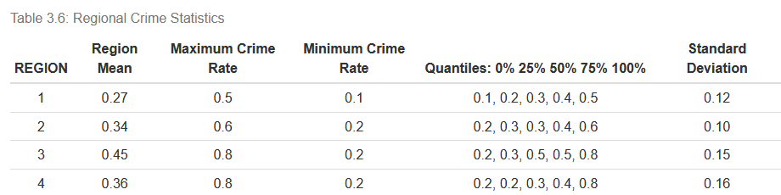
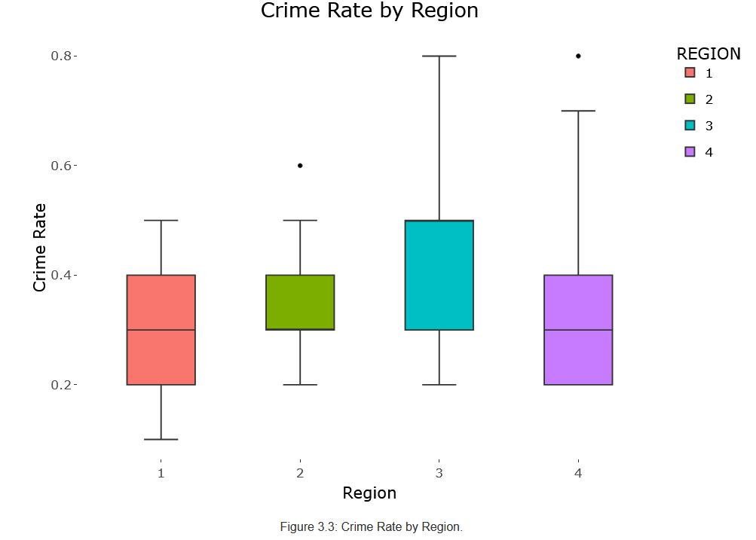
EDA analysis
Statistics were gathered for the crime rate in the data. A table for the region and given in the following slides.

Slide 21
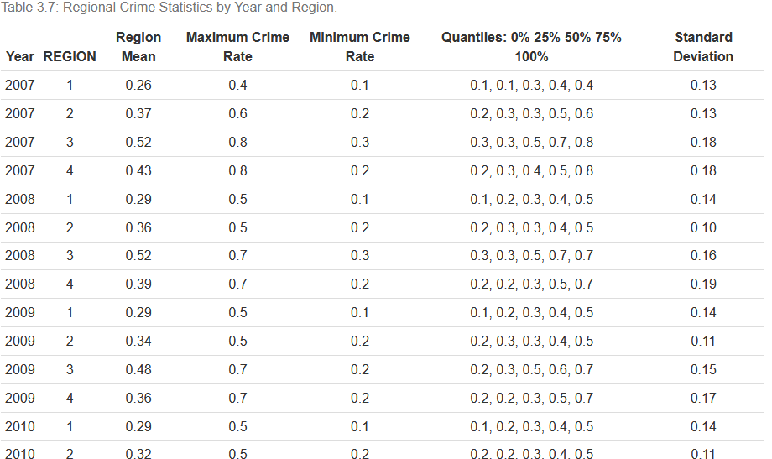
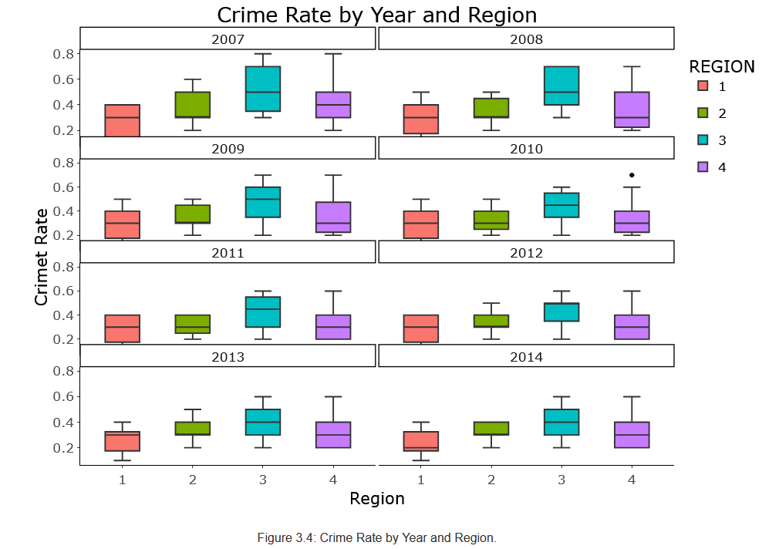
EDA analysis
Statistics were gathered for the crime rate in the data. A table for the region and by year and given in the following slides. Only a partial table is given for this data. Please refer to Table 3.7 for the complete table.

Slide 22
Data analytics method

Slide 23
Data analytics method
The data visualizations for the analytics that were produced for the project were the following:
A spatial map over the contiguous USA for the unemployment rate for the specific year 2014.
A spatial map over the contiguous USA for the crime rate for the specific year 2014.
Scatter plot for the data relationship between the unemployment rate and crime rate.
Time series plot for the four states for the unemployment rate
Time series plot for the four states for the crime rate

Slide 24
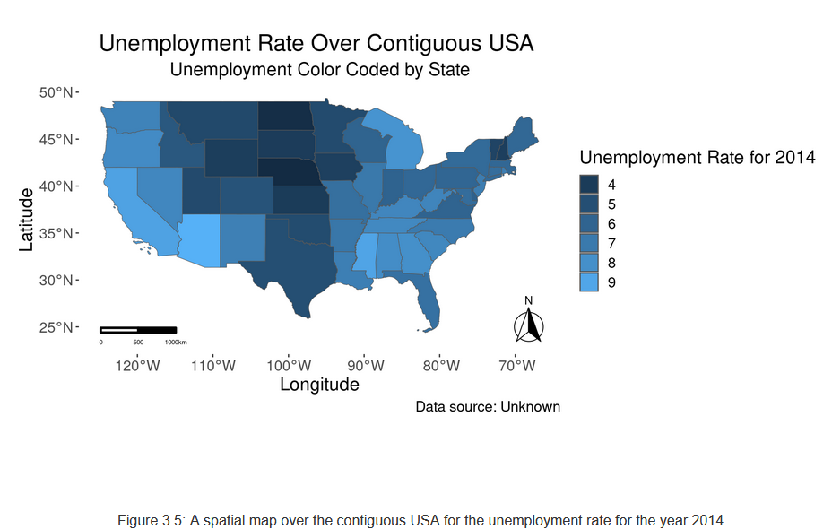
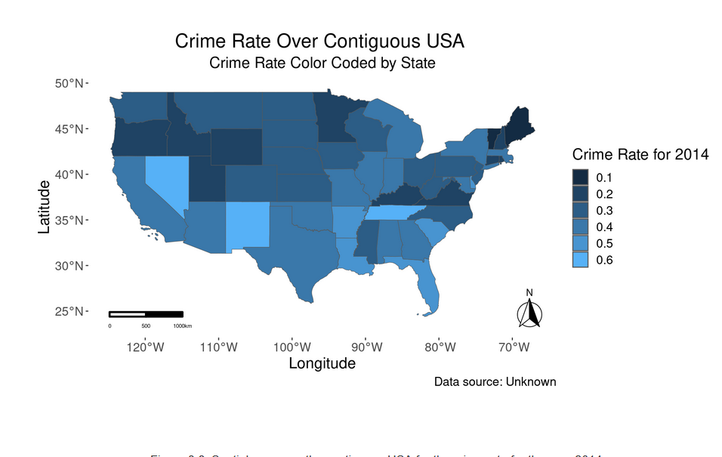
EDA analysis
There were a few spatial maps produced to see the data. These were for crime and unemployment rate over a given year. The year analyzed was for the year 2014. (Please refer to the HTML for more information.)

Slide 25
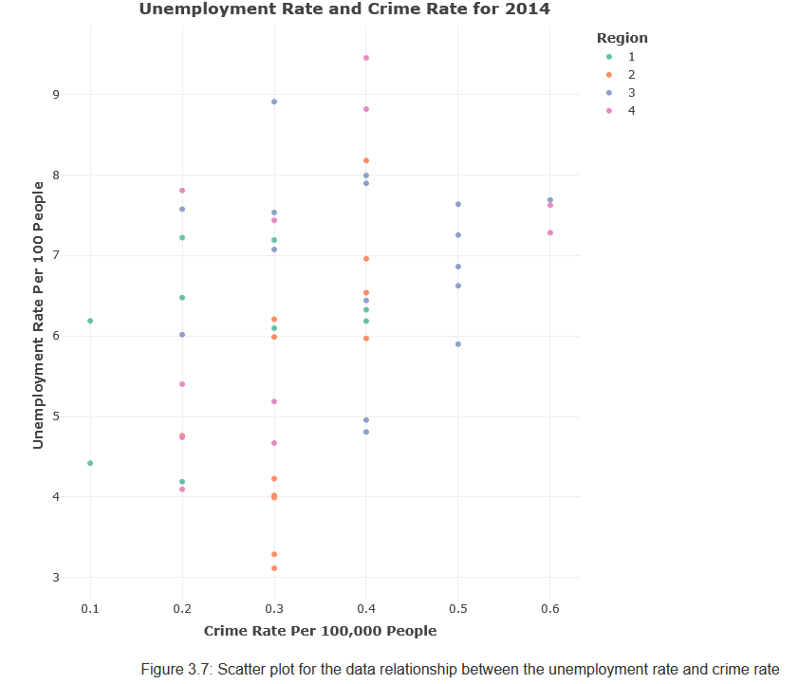
Data analytics method
There was a scatterplot to see if there was a linear correlation between the data points. The conclusion will be discussed in the following section of the report.

Slide 26
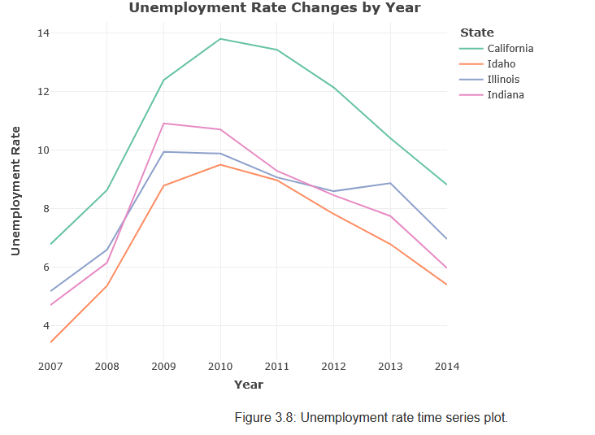
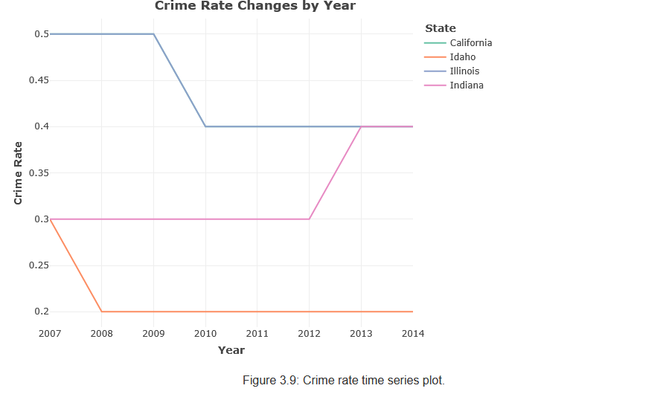
Data analytics method
There were time series graphs that were created for a few of the states in the data. Please note that these graphs are plotly graphs, and they are interactive for the states. Please see HTML file for the figures given below.

Slide 27
Discussion and Conclusion

Slide 28
Discussion and Conclusion
This project proposed to investigate if there was a relationship between changes in the unemployment rate and the crime rate. This project resulted in numeric and graphical data that can be used to answer the following questions:
Does the employment rate change over time and in a specific region of the country?
Can we discern a pattern or a correlation between the changes in the
Examining the statistics found in Section 3.1 EDA Analysis, we can see in tables that show some statistical measurements for the data. The tables and graphs show the quantiles, the mean, maximum, minimum, and any outliers for the available data. Table 3.4 Regional Unemployment Statistics. Shows the grouped data for all the years within the dataset. In Figure 3.1 Unemployment Rate by Region. Based on the boxplots regions 3 and 4 seem to have an extreme range in the unemployment rate for the period.

Slide 29
Data for each year as given in Table 3.5 Regional Unemployment Statistics by Year and Region, regions 3 and 4 usually have the highest mean unemployment rate over the period. To better illustrate the measurements that were given in the table, it may be helpful to look at a boxplot of the data over time. Using a faceted boxplot we can visualize the data for the regions for each year that there is data. Studying Figure 3.2 Unemployment Rate by Year and Region we can see that regions 2 and 4 do show the extremes in the unemployment rate.
Crime rate in aggregate. Looking at the data over time we can see that the regions with the highest mean change in crime rate are regions 3 and 4. In Table 3.6 Regional Crime Statistics we can see the statistics for aggregated crime rate. These statistics seem to correspond with the high unemployment rates in regions 3 and 4, as discussed previously. To visualize this data we can refer to Figure 3.3 Crime Rate by Region. In this boxplot, we can see the range in the rate of change in the crime rate for regions. Regions 3 and 4 have extreme changes in crime for the data.

Slide 30
Referring to Table 3.7 Regional Crime Statistics by Year and Region shows the crime rate statistics by year and the regions. Over the period regions 3 and 4 continue to show the highest change in crime. To make it easier to understand it may be beneficial to look at the boxplots of the crime rate change over the year 2007 to 2014.
This can be seen in Figure 3.4 Crime Rate by Year and Region the regions show consistently high changes in the crime rate. If we look at a spatial map for a year, is there a suggestion of any correlation between the crime rate and the unemployment rate? The first spatial map to be examined is for the unemployment this map can be found in Figure 3.5. The highest rate of unemployment for 2014 is about 9% for the states of Mississippi and Arizona. The state of Mississippi is in Region 3 and Arizona is in Region 4.
What does this mean for the crime rate for the states looking at Figure 3.6? The rates for these states in 2014 were in the range of 0.1 for Mississippi and 0.4 for the state of Arizona. While there does seem to be some discrepancy in terms of the crime rate change, this may be due to the time frame that was chosen to examine for the spatial map.

Slide 31
Sometimes it may be beneficial to look at the data points as they relate to each other. This can be accomplished using the scatterplot. In Figure 3.7, there is a scatterplot of the data for the year 2014, based on this plot there does not seem to be a linear relation between the unemployment rate and the crime rate. There does not seem to be a linear correlation between the data points as indicated by the graph (Question Video: Identifying the Linear Correlation from the Scattergraph, Nagwa, n.d.).
When looking at a few examples from the selection of states we can further look for a trend in in crime and the unemployment rate. Using the states of California, Idaho, Illinois, and Indiana we can see the unemployment rates from 2007 to 2014 (Please refer to Figure 3.8 Unemployment Rate Changes by Year and Figure Crime Rate Changes by Year 3.9. (Please note it may be beneficial to toggle the different states on and off by selecting them from the legend located on the right side of the graph.)

Slide 32
We can see that California had the highest unemployment in the years 2010 through 2014. California had a change in the crime rate that was greater than the other states that were listed in the graph. One thing to note is Illinois had a spike in the unemployment rate in 2013 and did not see a commensurate change in the crime rate as indicated by no change in the crime rate shown in Figure 3.9.
To look at this relationship in a numerical manner we can look at the correlation coefficient. If we look at the correlation coefficient 0.17. The value of 0.17 indicates that there is almost no correlation between the variables to indicate that there is a meaningful correlation between crime and unemployment rates. This value is very close to the value zero. For there to be a correlation between the variables the value needs to fall closer to either -1 or to 1. Values closer to -1 indicate a negative correlation indicating that the variables change in a negative relation to each other. If one of the variables increases the other will decrease and vice versa (Soetewey, 2020).

Slide 33
While looking at data utilizing different methods. It seems that we can determine that there may be a possible correlation based on the graphs, but using a scatterplot there does not seem to be a correlation between the unemployment rate and the crime rate. There is a natural tendency to think that as unemployment increases the crime rate will also increase and it seems to be true.
Upon further research into the subject of crime rate and unemployment, there is a correlation between the two. This correlation depends on the type of crime that is being examined. When there is high unemployment the type of crime will vary. Crimes that involve possible quality of living may be only marginally affected. For instance, larceny, burglary, and robbery have a positive relationship. Crimes that may not affect the quality of living like car theft do not show a positive correlation but illustrate a negative relationship. This is not to say that car theft does not go up if given the right circumstances (Fallahi & Rodríguez, 2014). For instance, car theft will go up if there is a period of expansion within the economy. This is logical since there will be a market for the cars and the parts that they contain.

Slide 34
For further investigative purposes, it might be beneficial to investigate the regions that were covered in the data to see what the prevalent form of employment is and see if there are any similarities in the type of work that may cause such high rates of unemployment.

Slide 35
5. References

Slide 36
Processing The Data
Fallahi, F., & Rodríguez, G. (2014). Link between unemployment and crime in the US: A Markov-Switching approach. ScienceDirect.
Question Video: Identifying the Linear Correlation from the Scattergraph, Nagwa. (n.d.). Identifying the Linear Correlation from the Scattergraph [Video]. Nagwa. https://www.nagwa.com/en/videos/909167139353/
Soetewey, A. (2020, May 28). Correlation coefficient and correlation test in R. Stats and R. Retrieved February 13, 2025, from https://statsandr.com/blog/correlation-coefficient-and-correlation-test-in-r/

